Slide 1
Workshop 20:
PHP - OOP
Brainster Web Development Academy

Slide 2
Exercise 1
Create a class Calculator.
It has 1 private property: $operations (that is set to an empty array [ ] by default)
Create four methods for calculator operations (+, -, *, /) which will accept two numbers. Make sure that the user cannot insert anything but integers. These methods will perform the calculation between the two numbers and return the result.
Create a new method log().
The log() method will push strings to the $operations array.
String format: "{Name of operation} $number1 and $number2. Result: $result".
Call this method inside each of the operation methods so that you log the result.
Write method printAllLogs() which will print all operations that were run so far.
Write method clearLogs() that will delete the logs for all the operations that we run so far.
Create an object of this class and run all the methods. Usage example:
$calculator = new Calculator();
$calculator->add(2, 5); //7
$calculator->printAllLogs(); //Adding 2 and 5. Result: 7.
2

Slide 3
Exercise 2
Create abstract class Transport and place it inside namespace Transport.
It has two 2 properties - $width and $height.
Write the constructor where you will set values for these 2 properties.
Add an abstract method price().
Create class Train that extends class Transport and place it inside namespace Land.
It has 2 properties - $electricity and $electricityPrice
Write the constructor where you will set values for these 2 properties.
Implement the price() method. It should return $width * $electricity * $electricityPrice.
Create class Ship that extends class Transport and place it inside namespace Water.
It has 2 properties $fuel and $fuelPrice.
Write the constructor where you will set values for these 2 properties.
Implement the price() method. It should return ((($width / 100) * $fuel) * $fuelPrice).
Create an index.php file where you will create 4 objects from class Train and class Ship.
Then create a new function which should calculate and print the lowest price from these 4 objects.
3

Slide 4
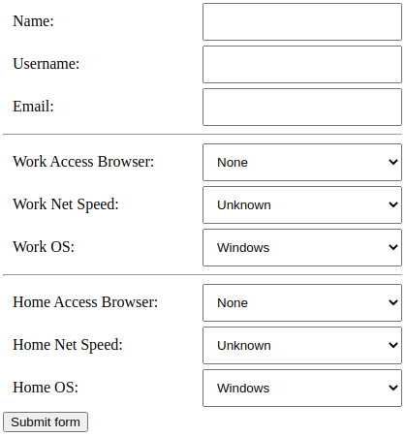
Exercise 3
Create a file named config.php containing 3 arrays as follows:
$browsers = ["None", "Firefox", "Chrome", "Edge", "Safari", "Other"];
$speeds = ["Unknown", "Fiber", "DSL", "Cable", "Dialup", "Other"];
$operatingSystems = ["Windows", "Linux", "Mac", "Other"];
Create a class Select.
It has 2 private properties: $name and $values (an array);
Write the constructor to set the value of the property $name.
Create the following methods in the class:
getName() – returns $this->name;
setValues() - must accept only array as parameter;
makeOptions() – For each element in $this->values, prints "<option value='{$value}'>{$value}</option>";
makeSelect() – creates <select> tag and calls makeOptions() method;
Create a file containing the form where the dropdowns will be created using the Select class’ methods.
When the form is submitted print out the values of each of the form’s element values. Usage example:
$workBrowserSelect = new Select('workAccessBrowser');
$workBrowserSelect->setValues($browsers);
$workBrowserSelect->makeSelect();
4

